Slide 1
CS410 Project
Prediction of Company Ratings using Sentiment Analysis
Suk-Lin Chan (slchan2)
Jing Jin (jingjin4)
Arthur Liou (arthurl3)

Slide 2
Overview
Collects text data from Glassdoor reviews for a select list of companies
Applies Latent Aspect Rating Analysis (LARA) technique for aspect segmentation and aspect ratings analysis
Applies Latent Root Regression (LRR) to train a model to predict and analyze the companies’ ratings in the following areas:
Work-life balance
Culture
Career Opportunities
Benefits
Management
Target Users
Job Seekers
Recruiters
Managers

Slide 3
Step 1: Environment Setup
Install Python 3.7 and Java 8
These are the versions the application was implemented and tested. We also recommend to use Anaconda and pip for Python package management.
Install/Update Chrome
Chrome version 78 is needed for browser automation.

Slide 4
Step 1: Retrieve review text & ratings of 5 aspects
Go to the data_collector directory
Run the following command to install required packages
pip install --user --requirement requirements.txt
If you run into a “module is not callable.” error, run python3 -m pip install --user --requirement requirements.txt
Open the data_collector.py file; enter username and password for your Glassdoor account
Run the following command to retrieve Glassdoor review data; the data is downloaded into the data_collector/data folder
python data_collector.py
Change the company name(s) in data_collector/data_collector.py to retrieve data for different companies

Slide 5
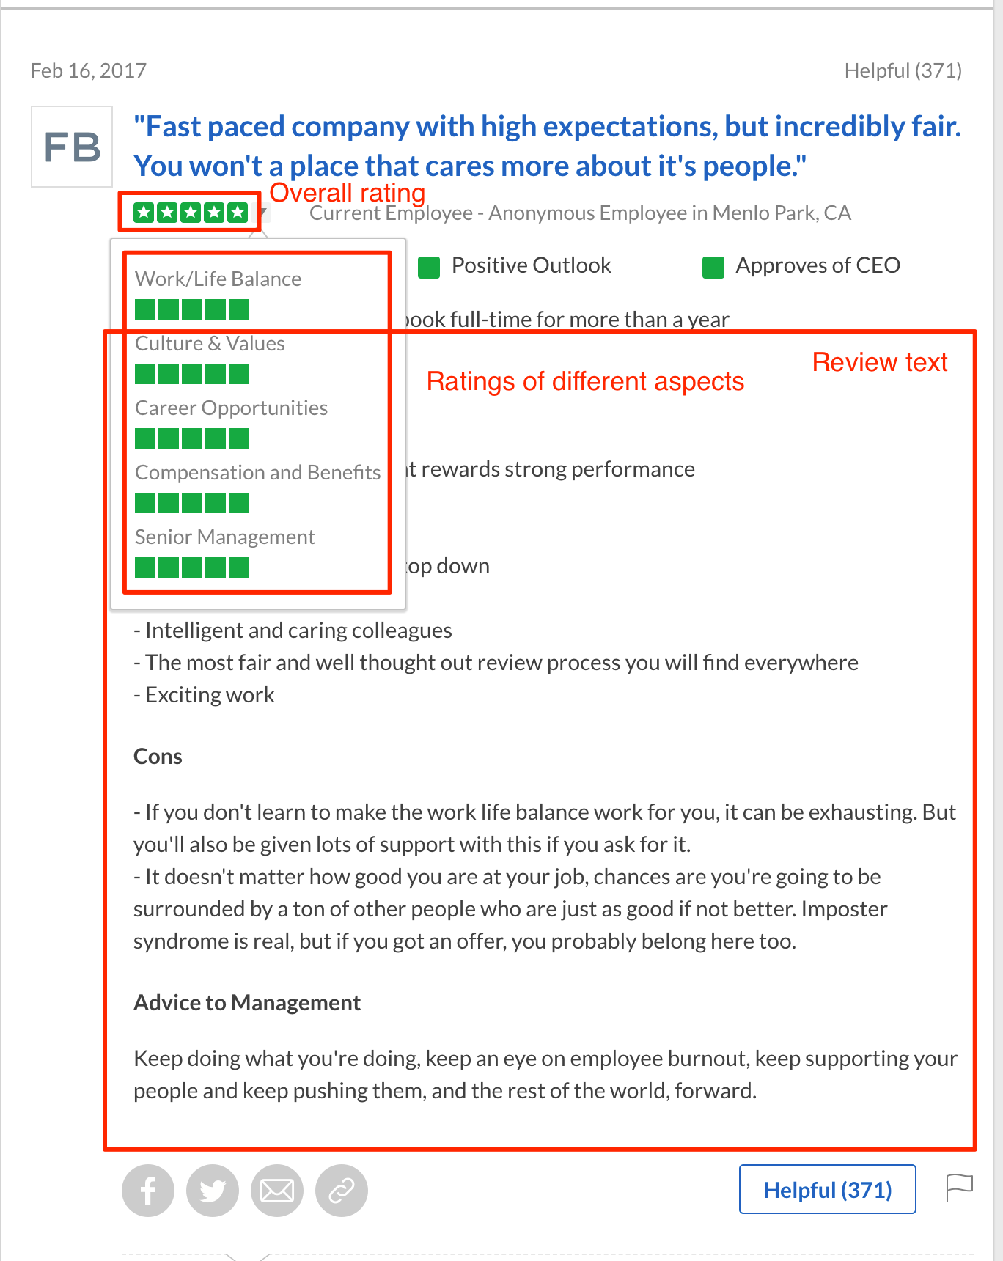
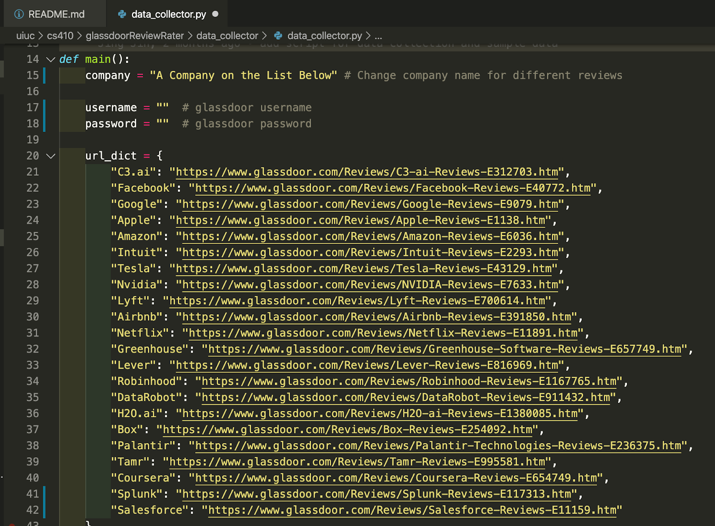
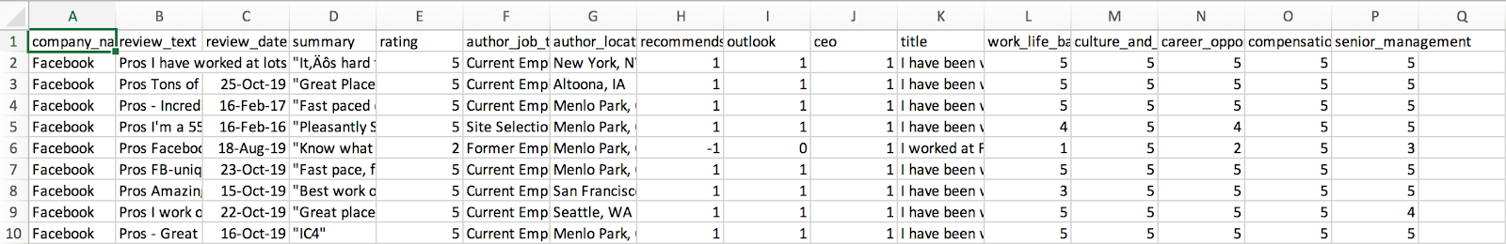
Step 1: Retrieve review text & ratings of 5 aspects (cont.)

Slide 6
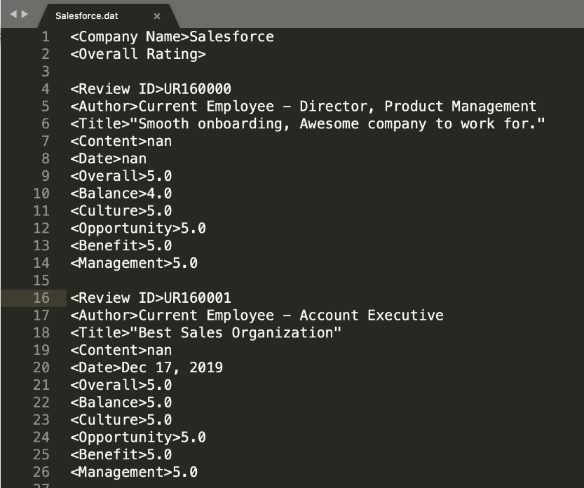
Step 2: Preprocess data for LARA input
Run the following commands in the data_collector directory to preprocess the raw data and copy the processed data to the LARA folder
python preprocess.py
cp -rf processed_data/*dat ../LARA/Data_Glassdoor/Reviews/

Slide 7
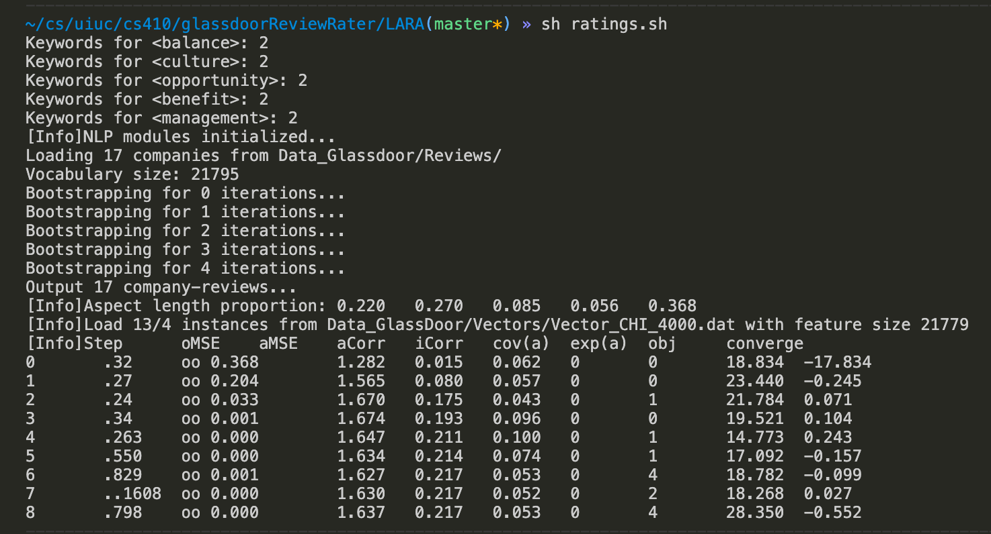
Step 3: Run LARA application
Run the following command in the LARA directory to build and execute the application
sh ratings.sh

Slide 8
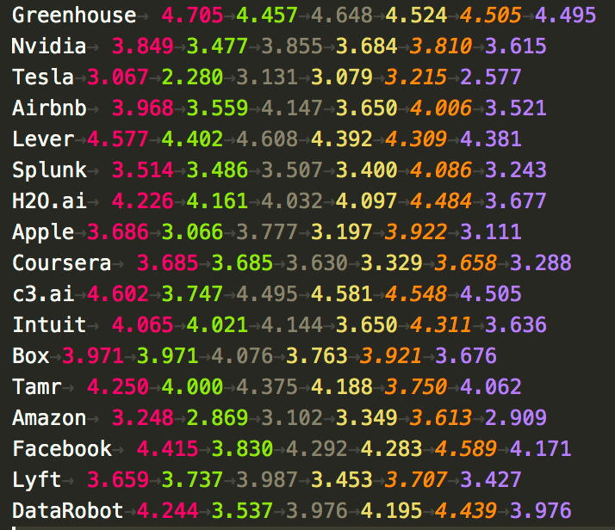
Output
Aspect segmentation Result
LARA/Data_Glassdoor/Seeds/glassdoor_bootstrapping_test.dat
Predicted ratings
LARA/Data_Glassdoor/Results/prediction.dat

Slide 9
Resources
Wang, Hongning & Lu, Yue & Zhai, Chengxiang. (2010). Latent Aspect Rating Analysis on Review Text Data: A Rating Regression Approach. Proceedings of the ACM SIGKDD International Conference on Knowledge Discovery and Data Mining. 783-792. 10.1145/1835804.1835903.
LARA Source Code
http://www.cs.virginia.edu/~hw5x/Codes/LARA.zip

